Slide 1
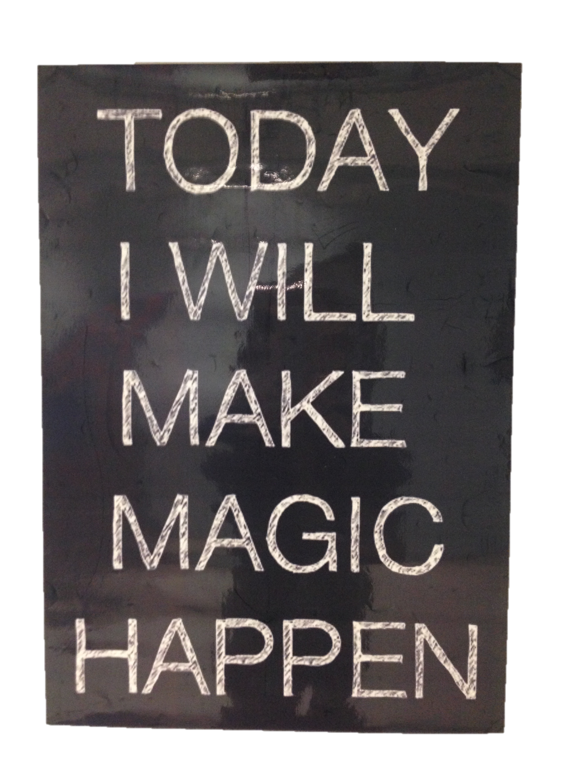
Be
Exemplary

Slide 2
Focus:
“Commit entirely to what is essential
and ignore the rest” Collins 2001

Slide 3
Shaping the Ball
Student
Centered
Pedagogy
Teaching
Strategies
Professional
Learning
Formative
Assessment
rick fisher 2014

Slide 4
High Expectations
Students as Customers of Instruction
Student-Centered Classrooms
Professional Learning
Assessment for Learning
Allen County Schools

Slide 5
3
Increase the level of knowledge and skill that the teacher brings to the instructional process.
2. Increase the level and complexity of the content that students are asked to learn.
Ways
To
Improve
Student
Learning
3. Change the role of the student in the instructional process.
Elmore 2009

Slide 6
1
53
Exemplary
Accomplished
34
Developing
Increase the level of knowledge and skill of the teacher
14
6
Ineffective
Marzano

Slide 7
Building Capacity
1
Teachers present
the ideas to rest of faculty and provide expert support.
Use teacher
Leaders to “Pilot” new initiatives.
Divide faculty into heterogeneous
learning teams.
Faculty meets back
monthly to share
student work and
discuss progress.
Increase the level of knowledge and skill of the teacher
Rick Fisher 2014

Slide 8
Building Capacity
1
Literacy Strategies
Thoughtful Ed.
Marzano 9
Writing
Grade level content teachers plan units together. Focus on understanding.
Effect Size .88
Common unit tests.
Quarterly Scrimmages.
Benchmarks
Peer Observation
Debrief
Expert Panel
Increase the level of knowledge and skill of the teacher
Rick Fisher 2014

Slide 9
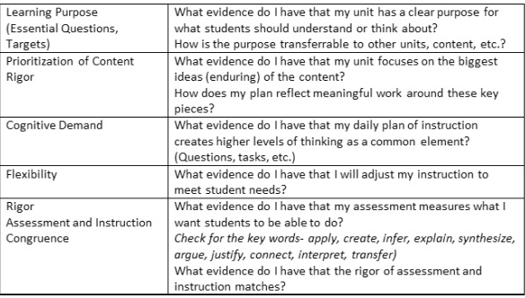
Building Capacity
1
Increase the level of knowledge and skill of the teacher
Rick Fisher 2014

Slide 10
Creating Challenge
2
Cognitive Demand
Discourse
Effect Size .88
Productive Struggle
Questioning
2. Increase the level and complexity of the content that students are asked to learn.
Effect Size .64
Metacognition
Effect Size .46 -.72
Effect Size .69
Rick Fisher 2014

Slide 11
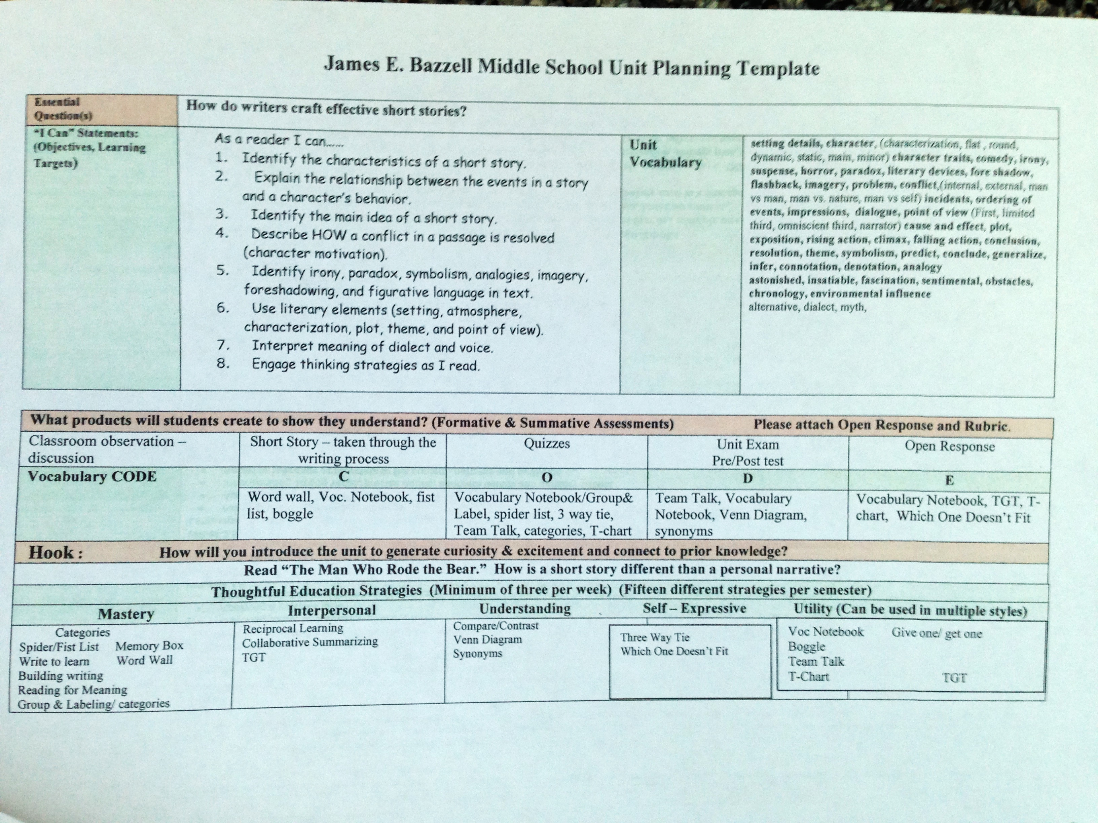
Rick Fisher 2008

Slide 12
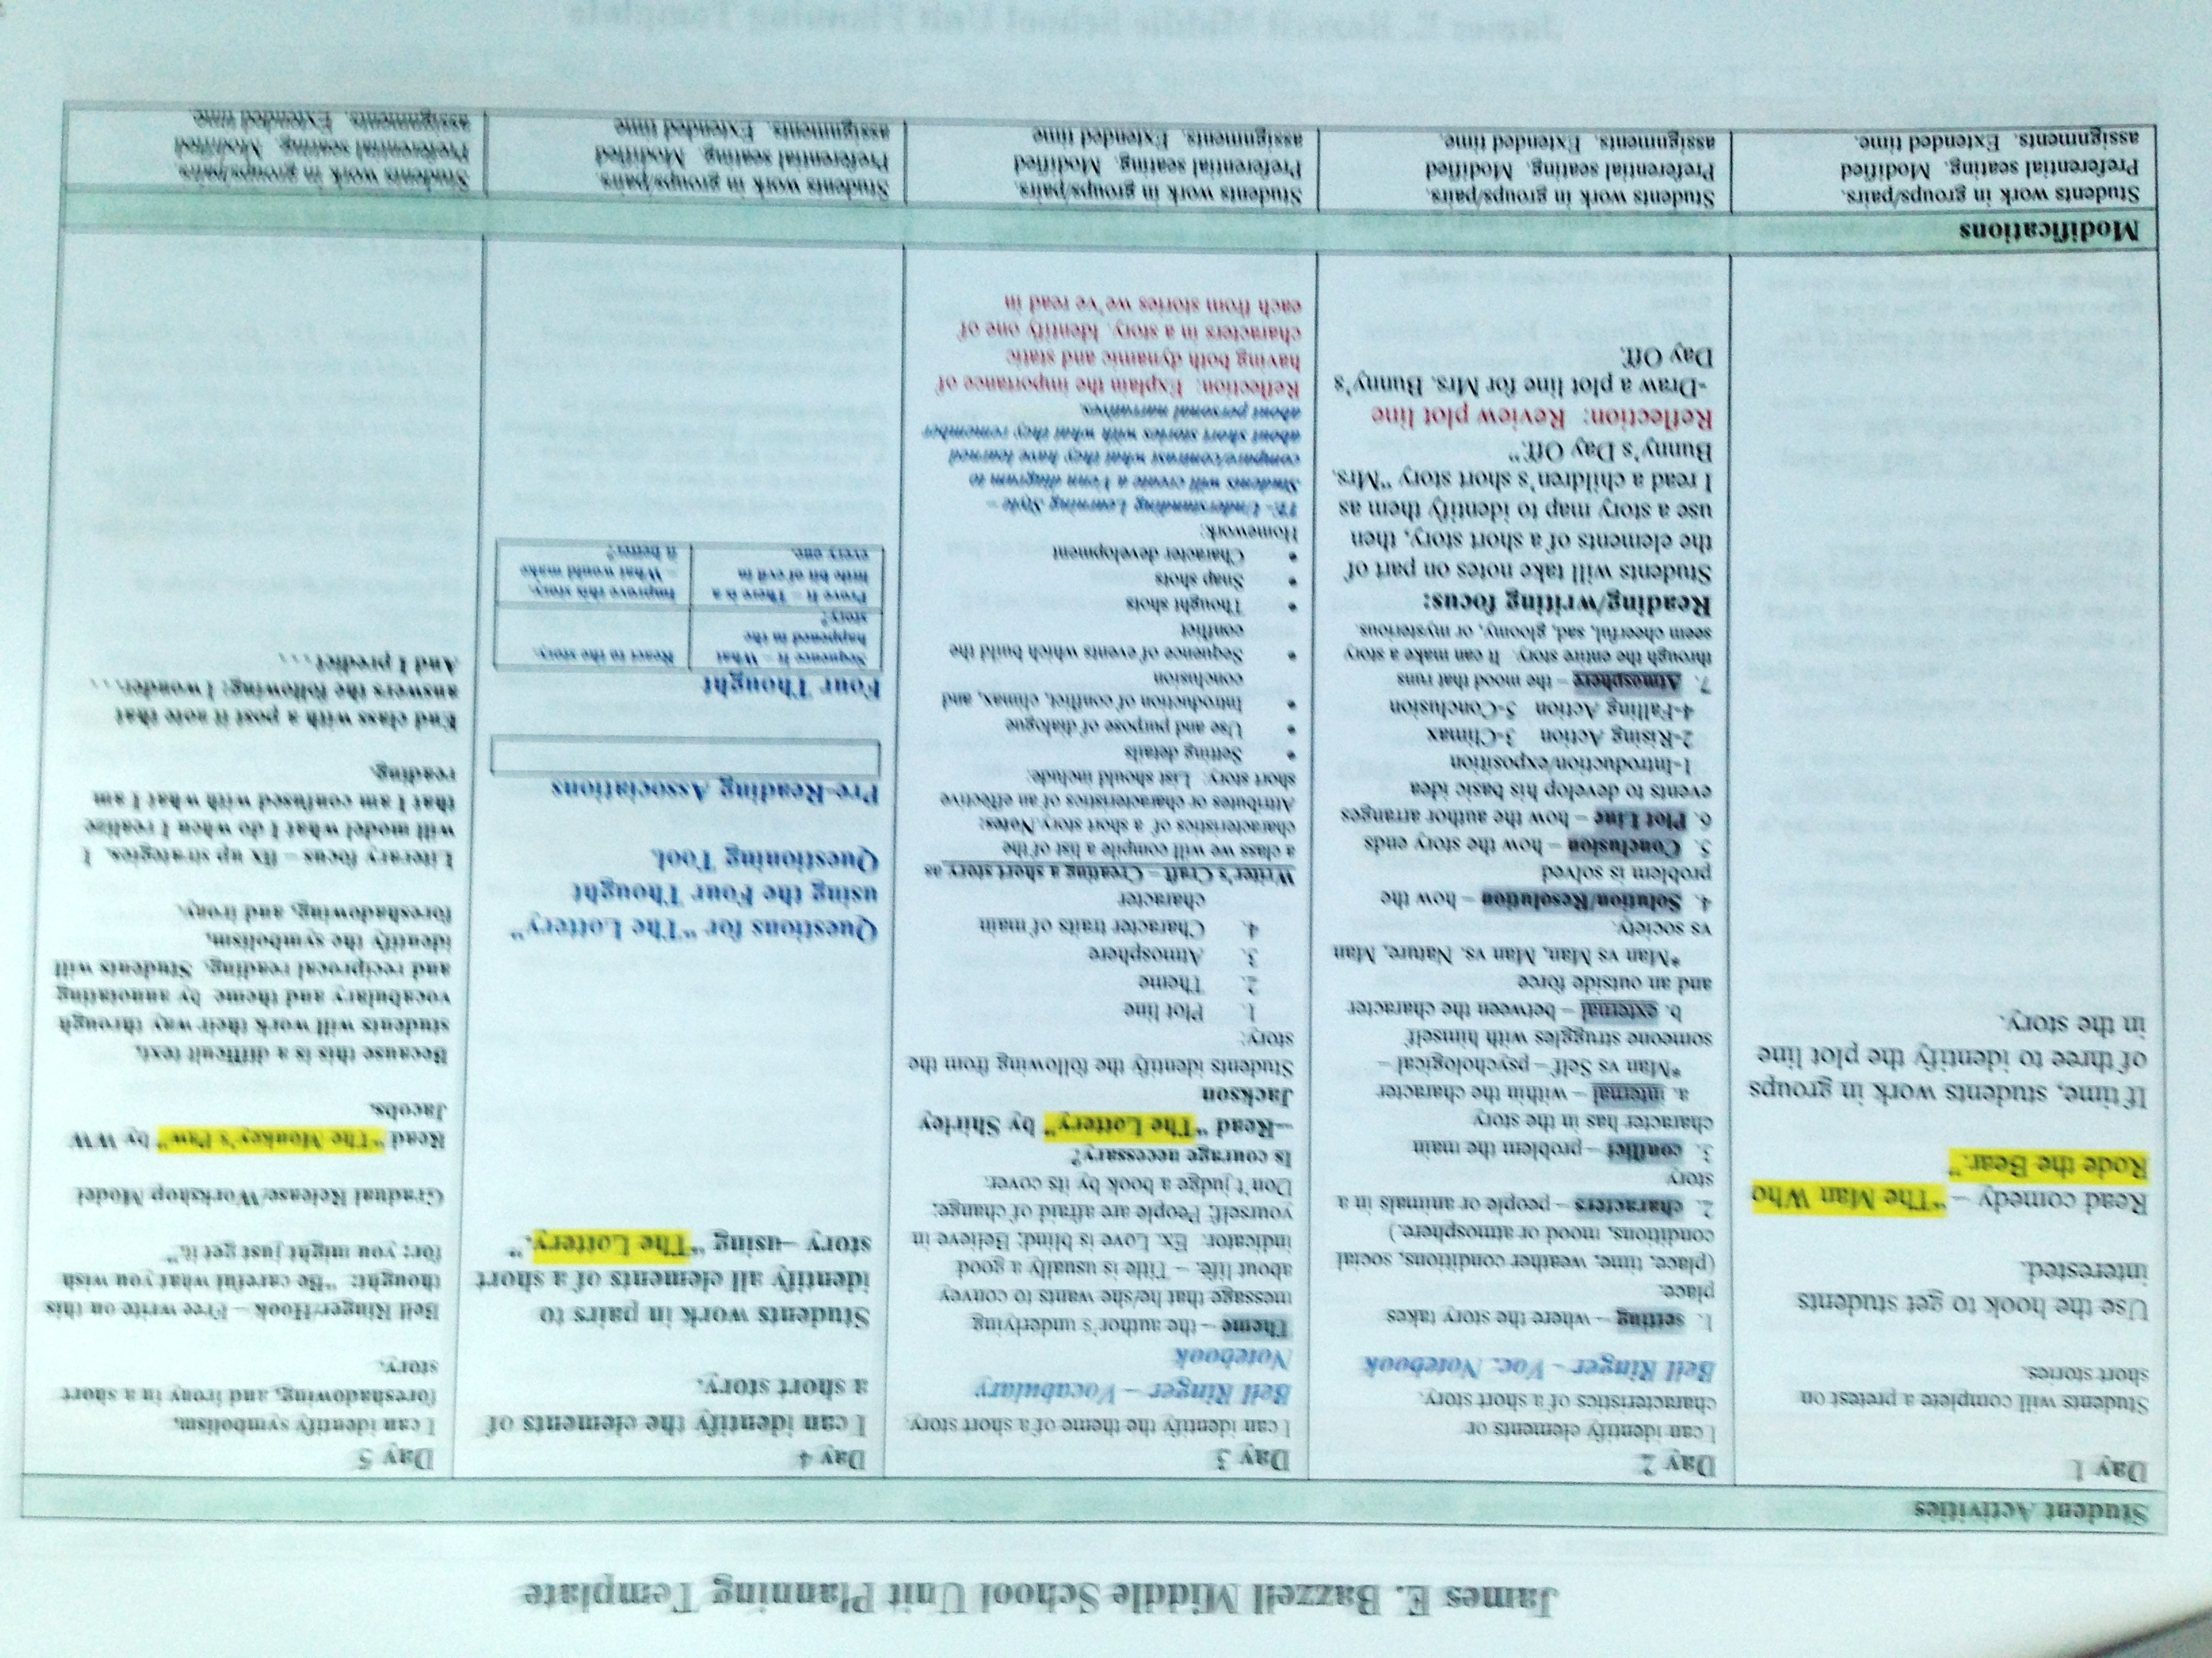
Rick Fisher 2008

Slide 13
Formative Assessment
1
Separate grades from fluff.
Don’t grade practice.
Offer Retests.
Teach
Assess
Pause/Reteach
Repeat
Common unit tests.
Quarterly Scrimmages.
Effect Size .88
Benchmarks
Pre & Post Tests
Using data to improve achievement.
Effect Size .90
Increase the level of knowledge and skill of the teacher
Student self assess & monitor progress = 1.44
Rick Fisher 2014

Slide 14
Instructional Strategies
2
High
Expectations
2. Increase the level and complexity of the content that students are asked to learn.

Slide 15
From: Talent Development as an Emerging Framework for
Gifted Ed: Paula Olszewski-Kubilius

Slide 16
A lesson in which students are engaged usually has a discernible structure: a beginning, a middle, and an end, with scaffolding provided by the teacher or by the activities themselves.
3c Engaging Students in Learning
3
The teacher organizes student tasks to provide cognitive challenge and then encourages students to reflect on what they have done and what they have learned. This is, the lesson has closure, in which students derive the important learning from their own actions.
3. Change the role of the student in the instructional process.
The best evidence for student engagement is what students are saying and doing as a consequence of what the teacher does, or has done, or has planned.

Slide 17
Why Student Centered?
..typically have both teacher-led and student-centered components, ..The typical sequence is for teacher-led explicit instruction to be followed by a gradual release of responsibility to the students themselves. The studies have shown that students who are taught to use a variety of cognitive and metacognitive strategies have greater gains in metacognitive awareness and academic achievement than students who do not receive the training.
Hattie & Anderman 2013
3
3. Change the role of the student in the instructional process.

Slide 18
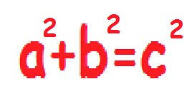
Workshop
Debrief –
Reflection
Minilesson
Exemplary
Practice
Student
Work Time

Slide 19
Direct Instruction – Mini-lesson
Scaffold
Connect
Hook
Define
Purpose
Model
Exemplary 3A
The teacher links the instructional purpose of the lesson to the students’ interests; the directions and procedures are clear and anticipate possible student misunderstanding. The teacher’s explanation of content is thorough and clear, developing conceptual understanding through artful scaffolding and connecting with students’ interest. If appropriate, teacher models the process to be followed in the task.
Rick Fisher 2014

Slide 20
Productive
Struggle
Partners/
Groups
Student
Work time
Promote
Discourse
Rigorous
Task
Exemplary 3B
Teacher uses a variety or series of questions or prompts to challenge students cognitively, advance high-level thinking and discourse, and promote metacognition. Students formulate many questions, initiate topics, and make unsolicited contributions. Students extend discussion and invite comments from their classmates.
Exemplary 3C
Virtually all students are intellectually engaged in challenging content through well-designed learning tasks and suitable scaffolding by the teacher.. In addition, there is evidence of some student initiation of inquiry and of student contribution to the exploration of important content. Learning tasks and activities are designed to challenge student thinking.
Rick Fisher 2014

Slide 21
Exemplary 3D
Assessment is fully integrated into instruction through extensive use of formative assessment. Questions, prompts, assessments are used regularly to diagnose evidence of learning by individual students. Teacher monitoring of student understanding is sophisticated and continuous: the teacher is constantly “taking the pulse” of the class. Feedback to students is specific and timely, and is provided from many sources including other students. While students are working, the teacher circulates, providing substantive feedback to individual students.
Teacher Moves
Feedback/
Questions
Student
Work Time
Assessing
Planning
Conferring

Slide 22
Debrief-
Reflection
Synthesis
Self-Assess
Share
Thinking
Connections
Exemplary 3C
Students summarize their learning from the lesson. Students have the opportunity for both reflection and closure after the lesson to consolidate their understanding.
Exemplary 3D
Students self-assess and monitor their progress. A variety of feedback, from both their teacher and their peers, is accurate, specific, and advances learning. The teacher uses exit tickets to elicit evidence of individual student understanding. Students offer feedback to their classmates on their work.
Rick Fisher 2014

Slide 23
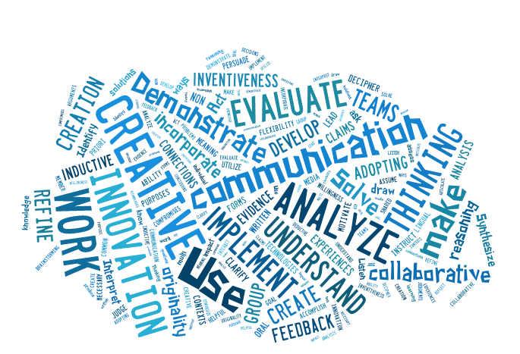
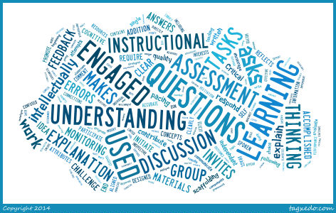
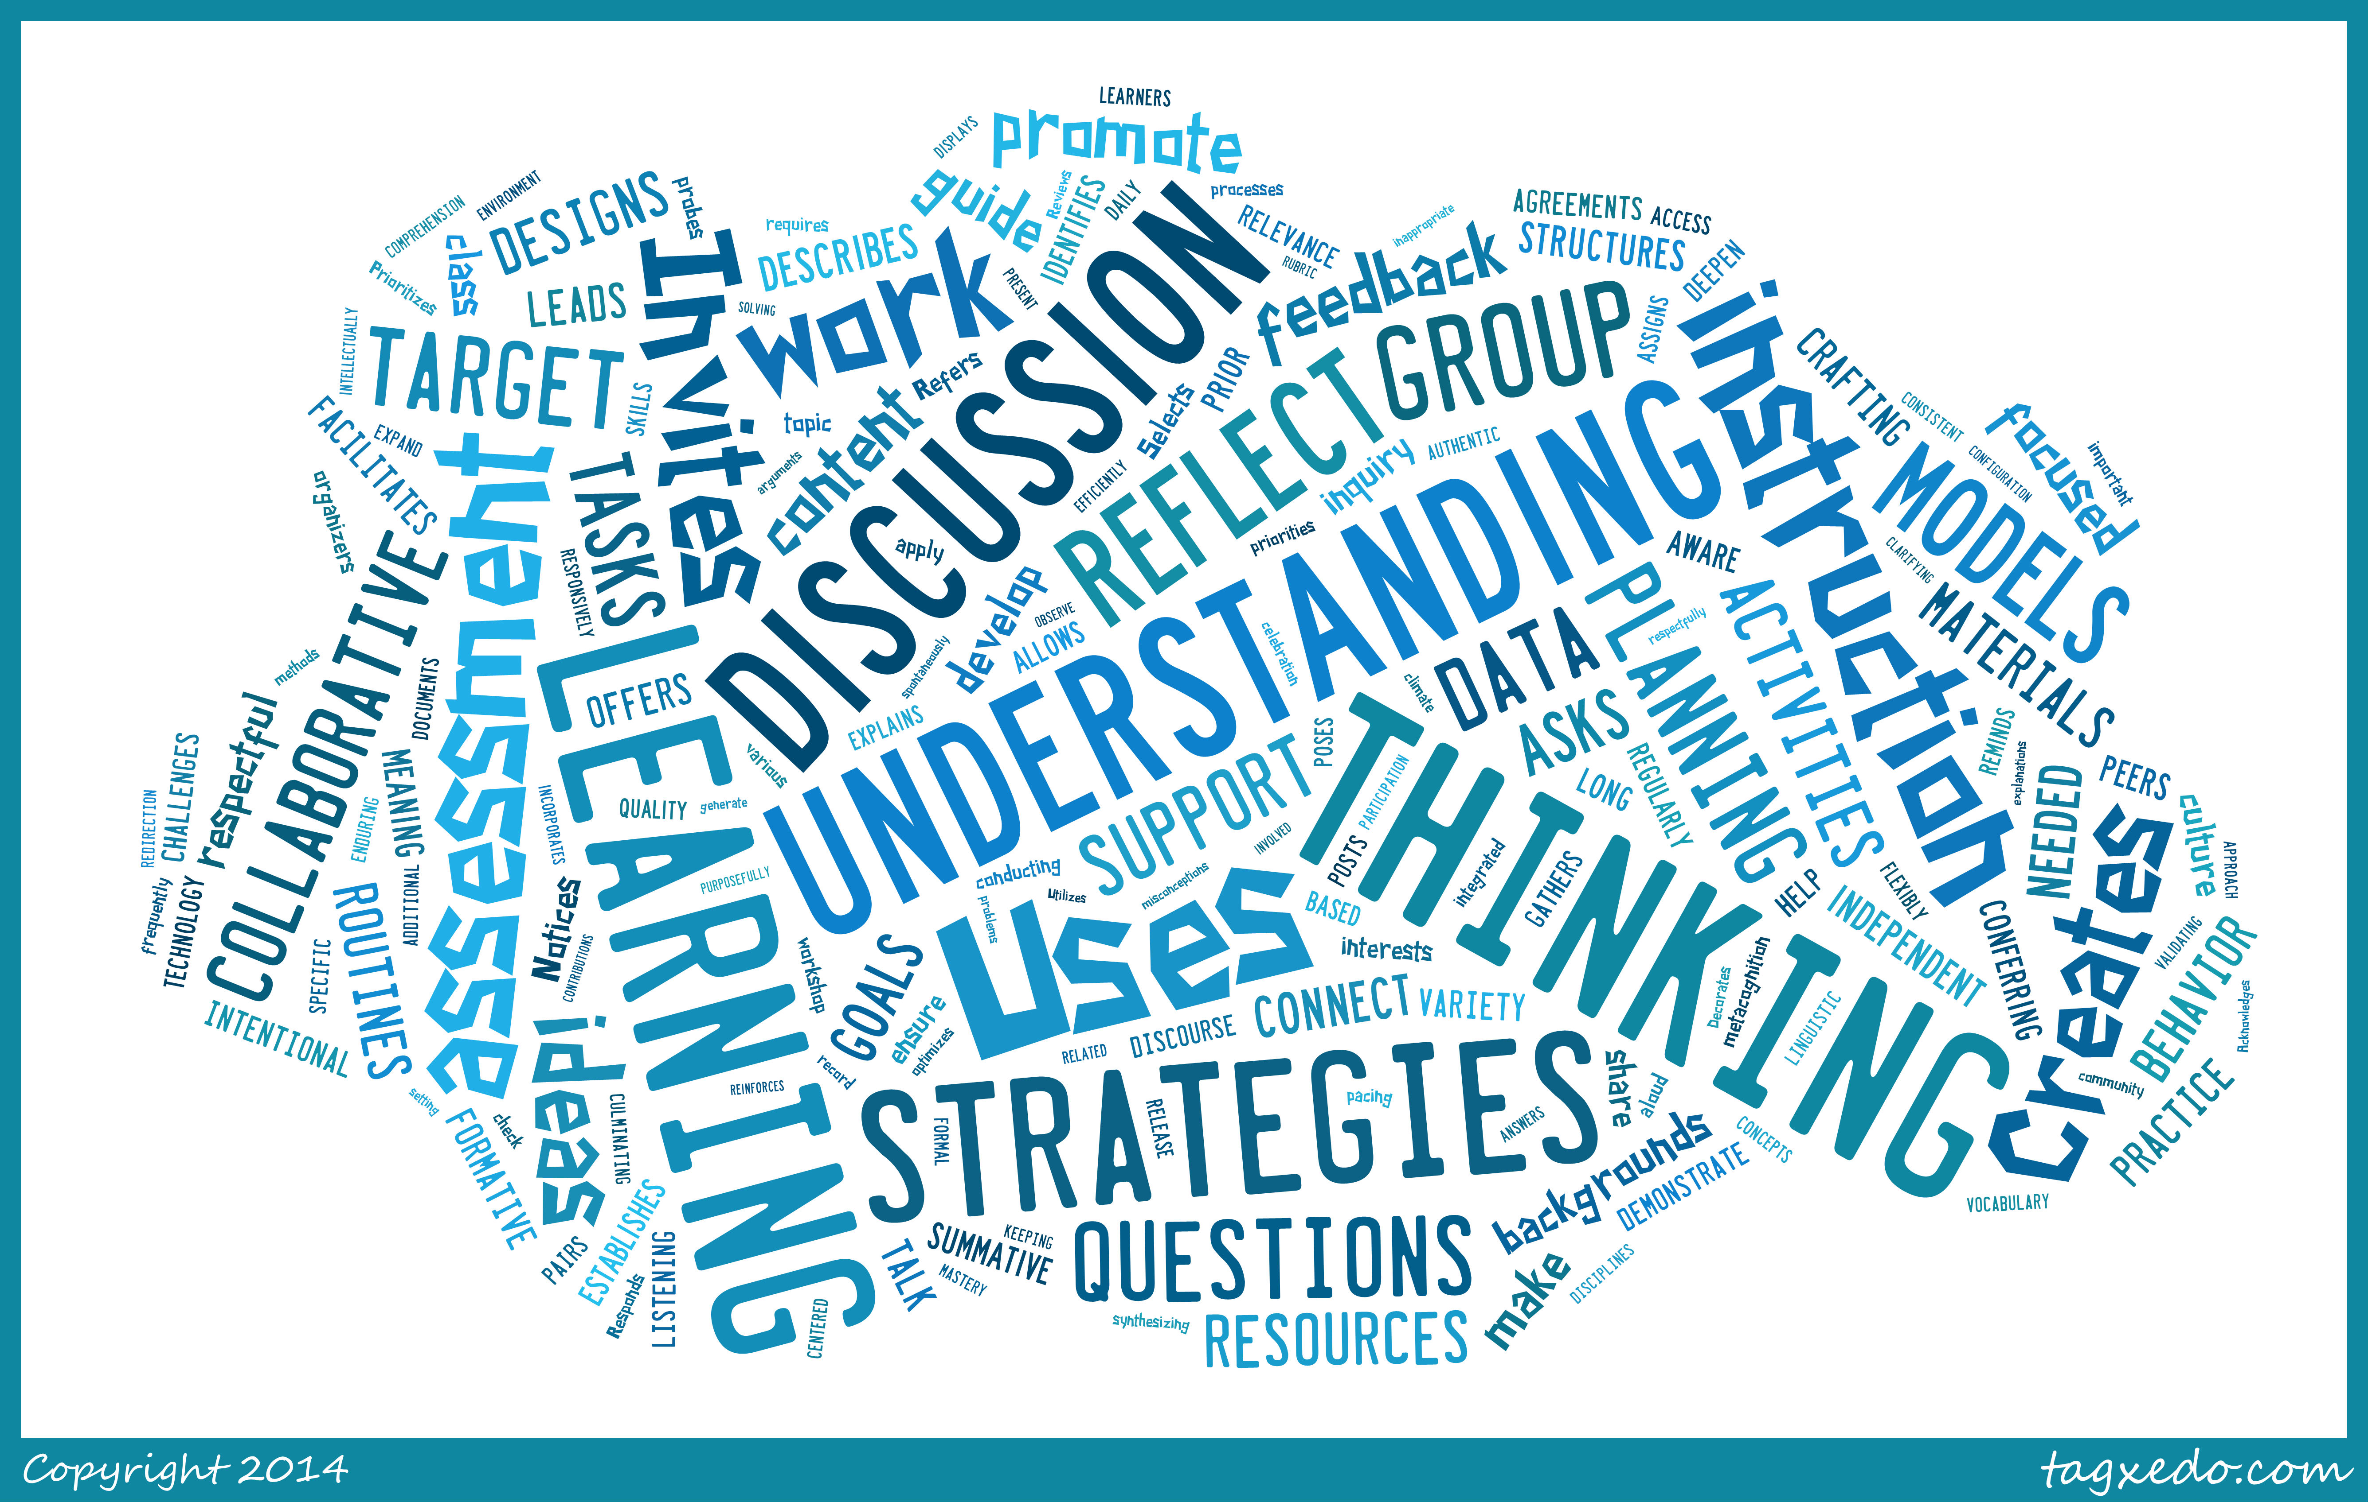
The skill connections
Danielson Domain 3
21st Century Learning Skills
Workshop & Thinking Strategies
Rick Fisher 2013

Slide 24
Thank You!
High Expectations
Students as Customers of Instruction
Student-Centered Classrooms
Professional Learning
Assessment for Learning
Allen County Schools
Rick Fisher 2011

